Slide 1
Decode the Encode
Characterization, and beyond

Slide 2
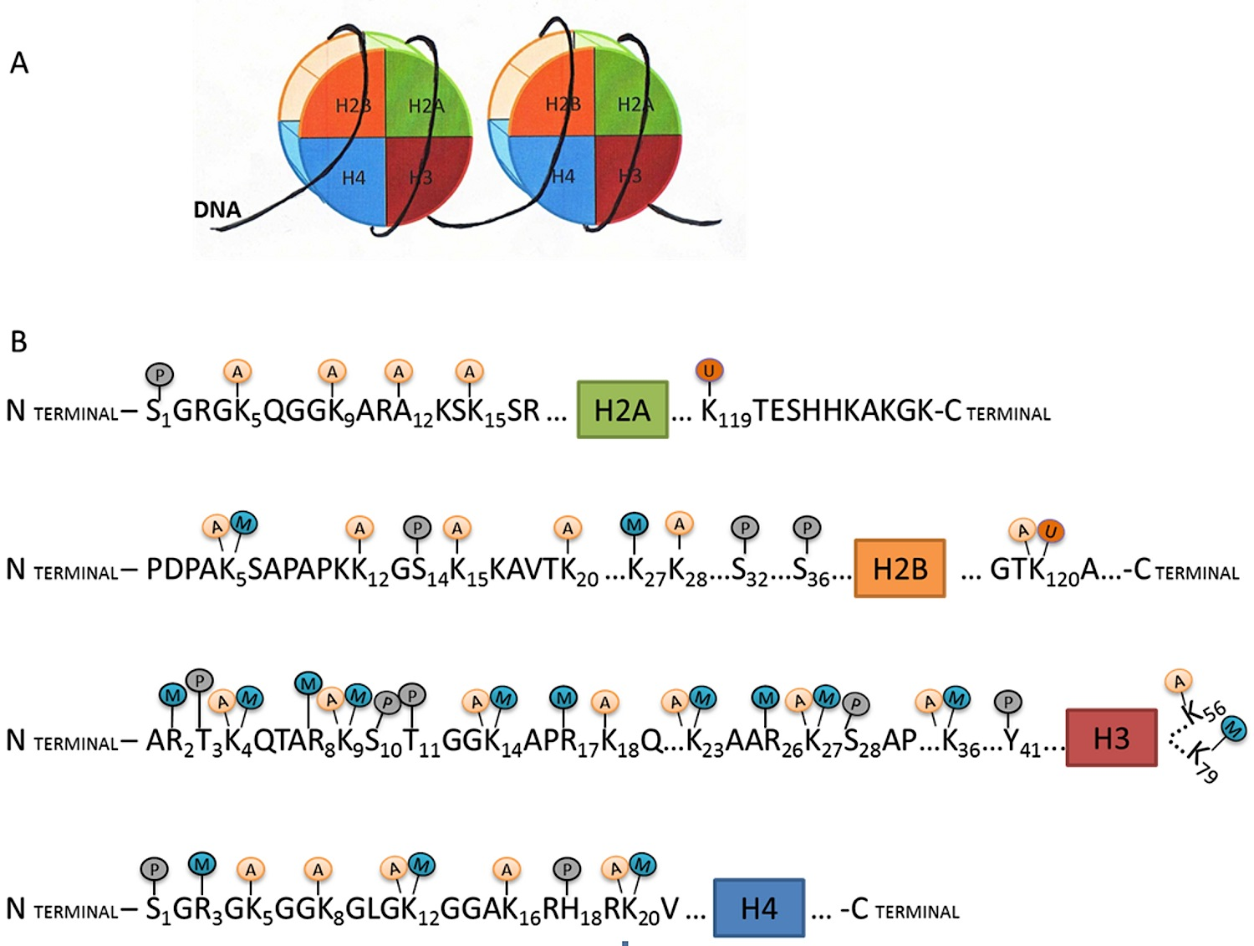
Epigenetic, transcriptional, and post-transcriptional regulation

Slide 3
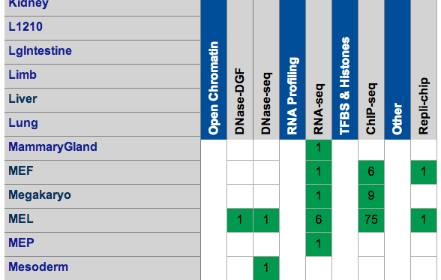
Mouse ENCODE
The goal of ENCODE is to build a comprehensive list of functional elements in the human genome, with pilot projects in model organisms, including mouse, Drosophila, C elegans.
 | RNA | H3k4me1, H3k4me3, H3k9ac, H3k9me3, H3k27ac, H3k27me3, H3k36me3, CTCF, Polr2a, P300
Cerebellum | UCSD-REN Adult 8 weeks
ES-Bruce4 | UCSD-REN Embryonic day 0
Heart | UCSD-REN Adult 8 weeks
Kidney | UCSD-REN Adult 8 weeks
Liver | UCSD-REN Adult 8 weeks
MEL | UCSD-REN
Intestine | UCSD-REN Adult 8 weeks
Spleen | UCSD-REN Adult 8 weeks
Testis | UCSD-REN Adult 8 weeks
Thymus | UCSD-REN Adult 8 weeks
Brain | UCSD-REN Embryonic day 14.5

Slide 4
Hypothesis
M
M
M
GENE
0 0 0 0 1 0 0 0 1 1 1 0 1 1 1 0 1 0
Binary genome in 200bp unit

Slide 5

How epigenomic features affect gene expression?
M
M
M
Promoter
5′ UTR
EXON
EXON
3′ UTR
Genetic regions
Promoter, TSS 1K, Promoter 2K, Promoter 5K, Transcript, Exon, Intron, UTR, Enhancer
Epigenomic features in given genetic regions
Length of coverage, number of peaks, coverage intensity, signal of the peaks
Histone marks and Transcription factors
H3k4me1, H3k4me3, H3k9ac, H3k9me3, H3k27ac, H3k27me3, H3k36me3, CTCF, Pol2, P300, Active Enhancer, Inactive Enhancer

Slide 6
Single epigenomic feature

Slide 7
Coverage of marks
Notes:
Roughly 50% of the marks fall within non-genetic region.

Slide 8
Enrichment

Slide 9
Linear regression

Slide 10
Pairwise regression
LogLik of interactive term in ESb4

Slide 11
Significant interactive terms

Slide 12
Effect with models
Models
rna ~ h3k36me3
rna ~ pol2
rna ~ h3k36me3 + pol2
rna ~ h3k36me3 * pol2

Slide 13
Stepwise AIC
Stepwise AIC

Slide 14
Mouse ENCODE
 | RNA | H3k4me1 | H3k4me3 | H3k27ac | H3k27me3 | CTCF | Polr2a
Cerebellum | UCSD-REN Adult 8 weeks
ES-Bruce4 | UCSD-REN Embryonic day 0
Heart | UCSD-REN Adult 8 weeks
Kidney | UCSD-REN Adult 8 weeks
Liver | UCSD-REN Adult 8 weeks
MEL | UCSD-REN
Intestine | UCSD-REN Adult 8 weeks
Spleen | UCSD-REN Adult 8 weeks
Testis | UCSD-REN Adult 8 weeks
Thymus | UCSD-REN Adult 8 weeks
Brain | UCSD-REN Embryonic day 14.5

Slide 15
Epi-genome hotspots
S1
S2
.
.
.
S10
S11
0 1 0 0 0 1 0 0 0 0 1 1 1 1 1 0 1 0
1 0 0 0 0 1 0 0 0 0 0 0 0 0 0 0 0 0
…
0 1 1 0 0 1 0 0 1 0 0 0 0 1 1 0 0 1
0 1 0 0 0 1 0 0 0 0 0 0 1 0 0 0 0 1
1 1 1 0 0 1 0 0 1 0 1 1 1 1 1 0 0 1

Slide 17
Epi-genome hotspots
Mark 1
Mark 2
…
Mark 4

Slide 19
Approach 2: gene specific
M
M
M
Promoter
EXON
EXON
RNA abundance
Intensity of the peak in the hotspots
Models:
Single correlation: Pearson’s and linear regression
Pair correlation: Each pair with interactive term

Slide 20
A starting point for studying interaction?

Slide 21
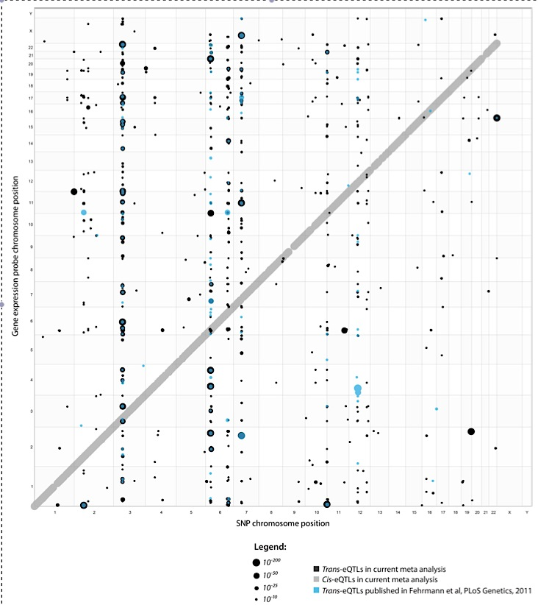
Positions of cis and trans-eQTLs
Systematic identification of trans eQTLs as putative drivers of known disease associations
2013 Nature Genetics

Slide 22
Pearson’s correlation

Slide 23
Enhancer
Active enhancers were defined as co-localized H3K4me1 and H3K27ac peaks with no H3K27me3 peak, whereas silent enhancers were considered loci with H3K4me1 and H3K27me3 peaks but no H3K27ac peak. Loci were filtered to be located distant to TSSs (500 bp) and exons (200 bp) of protein-coding genes, multi-exonic noncoding genes and mRNAs (from ENSEMBL, GENCODE (v10), RefSeq and UCSC, downloaded January 12, 2012), and other lncRNAs from a gene-centric set derived from literature40 as well as manually annotated sense-antisense pairs (coding-noncoding and noncoding-noncoding sense-antisense pairs) with 5′ expressed sequence tag (EST) and complementary DNA support, and 5′ ESTs with no locus with protein-coding capacity.
CTCF binding, as mammalian insulators are generally understood to require CTCF to block promoter-enhancer interactions
transcriptional coactivator protein p300 (Tables S2–S4) as p300 is known to localize at enhancers
Typical of enhancers, identified elements were generally located within 1-200 kb away from the nearest transcription start site
simultaneous enrichment of H3K27ac and H3K4me1 at flanking regions and absence of H3K4me3

Slide 24
Select interesting interaction terms and plot the interaction effects graphs
Create nice graphs

